Slide 1
Revisiting Topics
CIS 4930 / 5930. Offensive Computer Security. Spring 2014

Slide 2

Outline
Stack cookies
SSL bugs this year
iOS GOTO FAIL
GNU Utils
OPENSSL…
Akamai’s private key leaked
SSL, Certs, CA’s and the rise of signed malware
Big picture

Slide 3
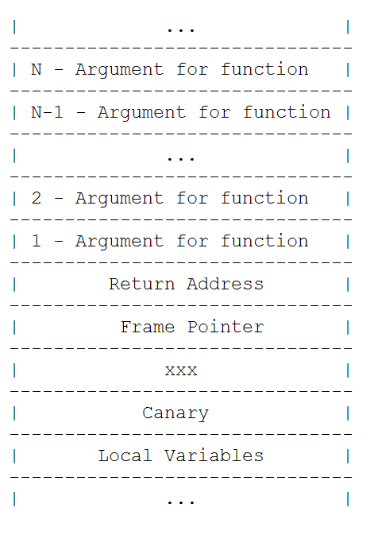
Stack Cookies
http://phrack.org/issues/67/13.html#article

Slide 4
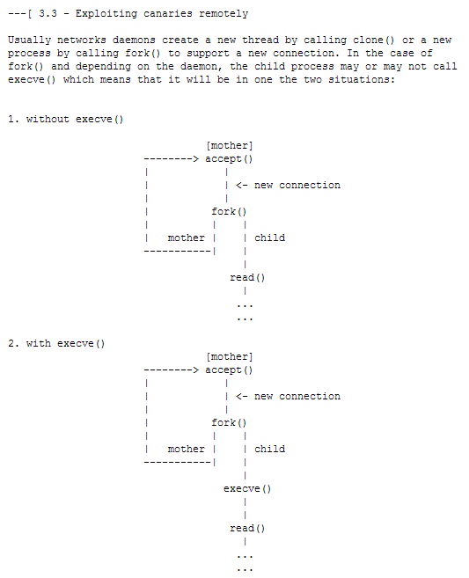

Slide 5
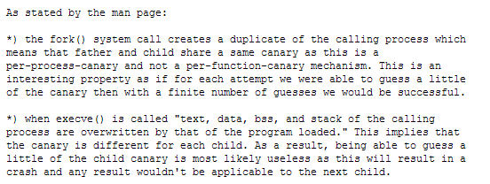

Slide 6
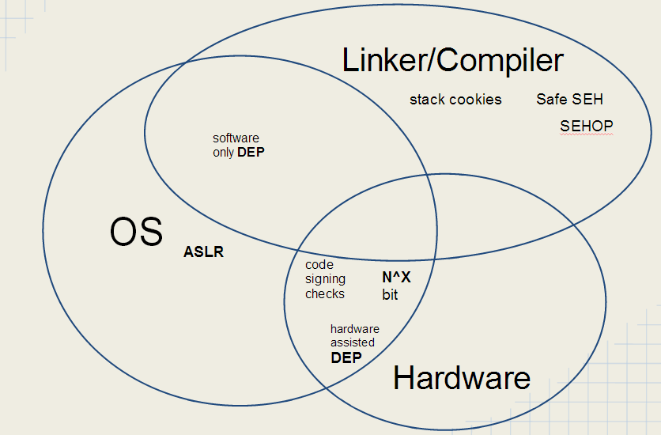

Slide 7
What you should know
void foo(...)
{
stack_buffer_overflow()
}
How to exploit this:
with stack cookies
+ DEP
+ ASLR
Require another bug/weakness?
Then think about how to further mitigate

Slide 8
What you should know
void foo(...)
{
heap_buffer_overflow()
}
How to exploit this:
(depends on heap algorithms)
with stack cookies
+ DEP
+ ASLR
Require another bug/weakness?
Then think about how to further mitigate

Slide 9
What you should know
void foo(...)
{
integer_bug_+_arbitrary_write()
x[i] = blah
//x[-59] = new return address…
}
How to exploit this:
with stack cookies
+ DEP
+ ASLR
Require another bug/weakness?
Then think about other mitigations:
CFI
EMET suite

Slide 10
What you should know
void foo(...)
{
// you only control upper half of an address
partial_arbitrary_byte()
}
How to exploit this:
with stack cookies
+ DEP
+ ASLR
Require another bug/weakness?
Then think about other mitigations:
CFI
EMET suite

Slide 11
What you should know
void foo(...)
{
// you only control upper half of an address
use_after_free()
}
How to exploit this:
with stack cookies
+ DEP
+ ASLR
Require another bug/weakness?
Then think about other mitigations:
CFI
EMET suite

Slide 12
What you should know
void foo(...)
{
// you only control upper half of an address
use_of_uninitialized_variables()
}
How to exploit this:
with stack cookies
+ DEP
+ ASLR
Require another bug/weakness?
Then think about other mitigations:
CFI
EMET suite

Slide 13
What you should know
void foo(...)
{
// you only control upper half of an address
format_string_bugs()
}
How to exploit this:
with stack cookies
+ DEP
+ ASLR
Require another bug/weakness?
Then think about other mitigations:
CFI
EMET suite

Slide 14
Going Further
Now imagine each of these:
Local priv esc, inside sandbox, against AV
What beats Signature based AV?
Remote exploitation
Through firewall? Through WAF?
How does having to work with encoding affect exploitability for each?
Does it actually affect exploitability?
or just the payload execution/delivery???

Slide 15


SSL Bugs
https://www.imperialviolet.org/2014/02/22/applebug.html
http://arstechnica.com/security/2014/03/critical-crypto-bug-leaves-linux-hundreds-of-apps-open-to-eavesdropping/
http://heartbleed.com/

Slide 16
How Big?
http://mashable.com/2014/04/09/heartbleed-bug-websites-affected/

Slide 17
How Heartbleed Works
http://xkcd.com/1354/

Slide 18

Akamai hit by Heartbleed
http://en.wikipedia.org/wiki/Akamai_Technologies
Had a custom patch for heartbleed; still vulnerable:
http://www.computerworld.com/s/article/9247650/Akamai_admits_issuing_faulty_OpenSSL_patch_reissues_keys
Attacked.
Impact: over 30% of all internet traffic exposed.

Slide 19
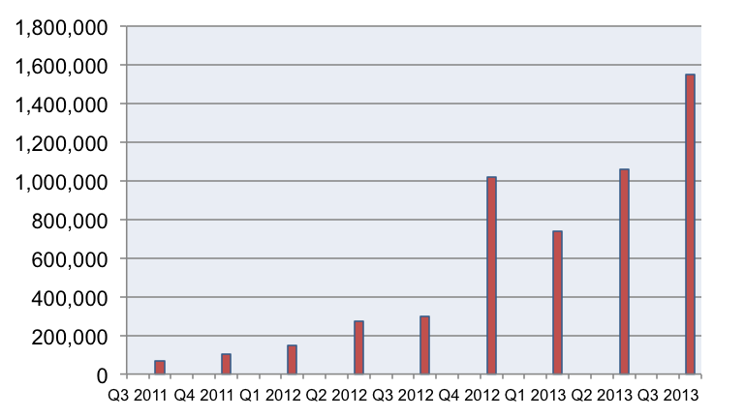
Digitally Signed Malware
over 1.5 digitally signed NEW malware in 2013:
https://blogs.mcafee.com/mcafee-labs/digitally-signed-malware-just-what-can-you-trust-now

Slide 20
Big Picture
Security
Confidentiality
Integrity
Availability
Exploitation / Hacking grants attackers Access
DoS to replay attacks to remote code execution

Slide 21

Big Picture
0days
Click jacking
XML Injection
FLASH / FLEX
AJAX
Packet Sniffing
0days
Web Service
Directory Traversal
Web Server
0days
SQL injection
Database
Parameter Tampering
FIREWALL
XSS
Forged Tokens
Direct Object Reference
CSRF
0days
Authentication Service
Access Control
(Java) APPLETS
0days
Silverlight
AND MORE

Slide 22
Next Week
Social Engineering
Physical Security
Take Home Final Exam

Slide 23

Questions?

